Slide 1
Final Project Uniform Inventory Forecasting

Slide 2
Project Topic: Uniform Inventory Prediction
Why -Optimized Inventory Management
The primary goal is to optimize uniform inventory levels, ensuring stocks to meet demand. Accurate predictions reducing holding costs and the risk of stockouts.
How -Time Series Forecasting For Stock Level Prediction:
Implementing the Prophet model for forecasting by analyzing historical data. This model is applied individually to each uniform item to predict future inventory levels, considering trends and seasonality.
Evaluation -Enhanced Resource Allocation:
The prediction are evaluated using metrics like Mean Absolute Error (MAE) to quantify accuracy. This process aids in understanding the model's performance and is instrumental for future inventory planning with adequate coverage.

Slide 3
Workflow:
Data Collection
Uniform consume excel data from email to Google Drive
Data Storage and Transformation
Through Google Service API to connect data to databricks notebook
Model Fitting
Prophet
Data Visualization
Model Evaluation
Concat dataframes with using “utf-8” format for Chinese wordings
Use Pandas for data masking & transformation
Linear Regression
Mean Absolute Error (MAE)
Adjustment by Categories
Connect Databrick with PowerBI to auto update the polt tables

Slide 4
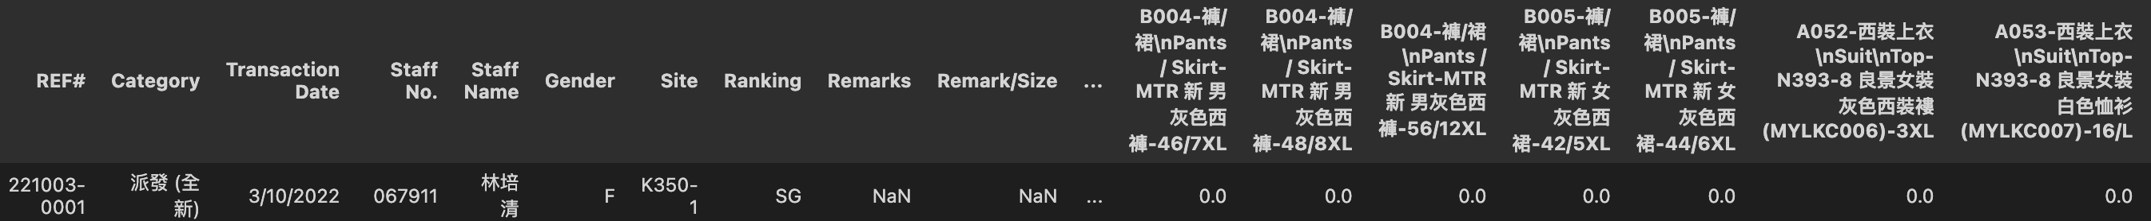
2) Data Storage and Transformation
From Daily Data
Group by Items and Sum the Consumed Uniform

Slide 5
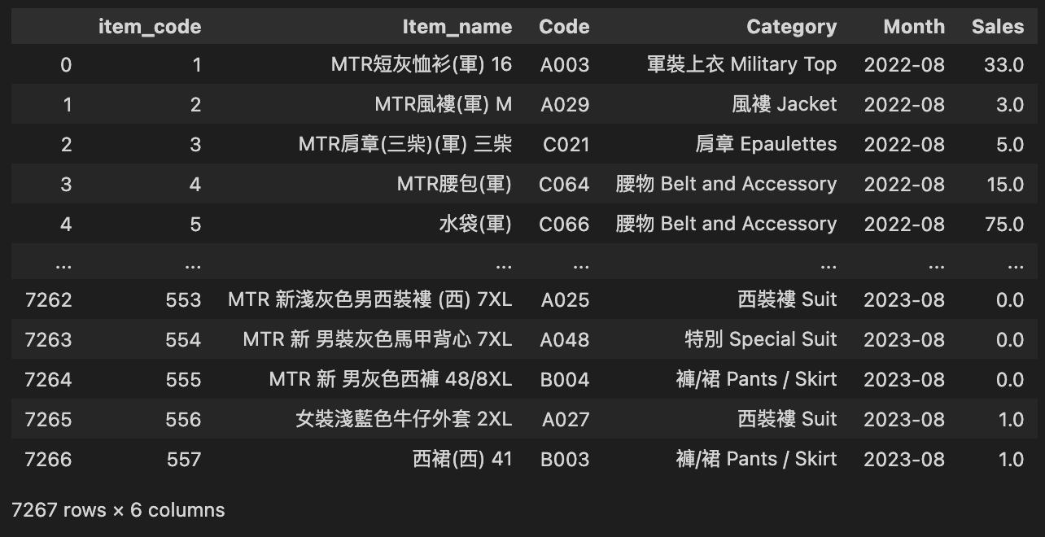
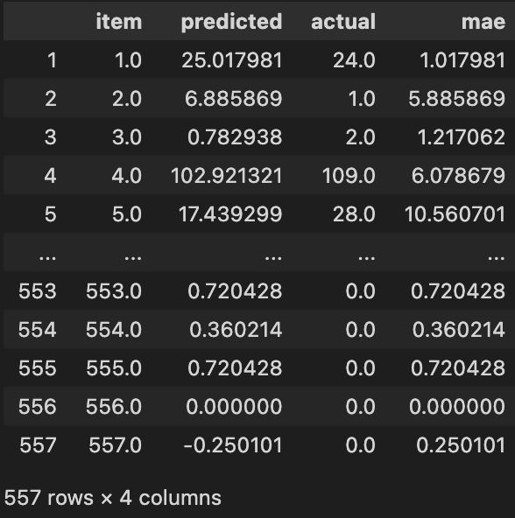
3) Model Fitting
12 months data for training, 1 month data for testing:
1) Prophet
A) By Each Item
– Result (MAE) = 6.04
B) By Each Category
– Result (MAE) = 10.43
2) LinearRegression
By Each Item – Result (MAE) = 4.24

Slide 6
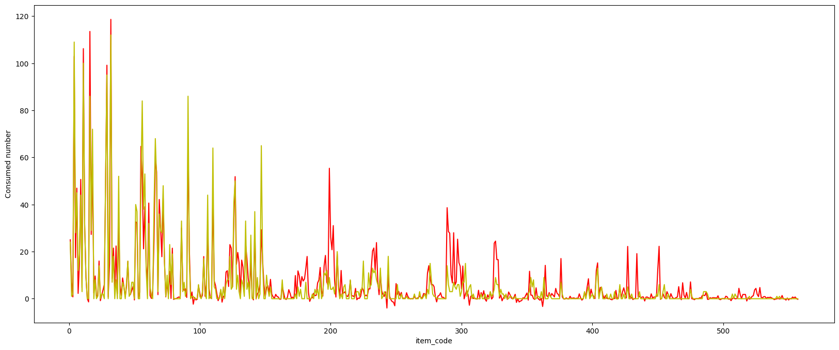
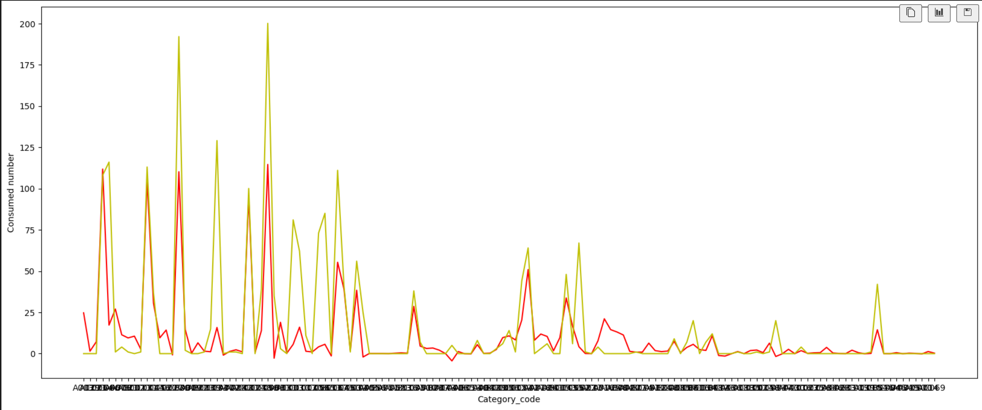
3) Model Fitting
A) By Each Item (557 items) B) By Each Category (135 items)
– Result (MAE) = 6.04 – Result (MAE) = 10.43

Slide 7
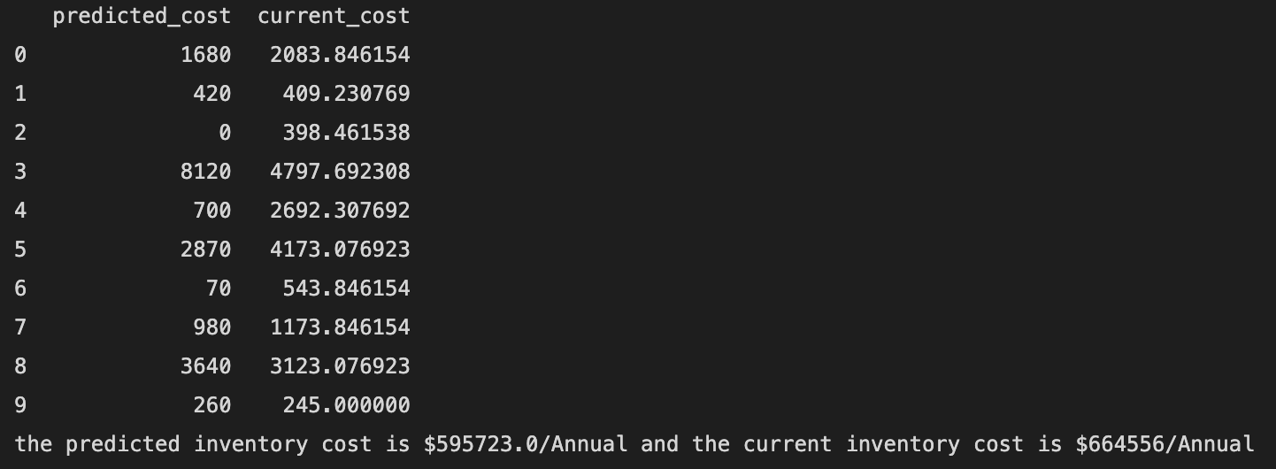
4) Model Evaluation & improvement
LinearRegression / By Category more suitable
Too less data for training (only 12 point for each item)
Aug 23 – Special Event, Therefore MAE level increased
Evaluation % of Category / % of Site / % of F/M
Inventory Costing:

Slide 8
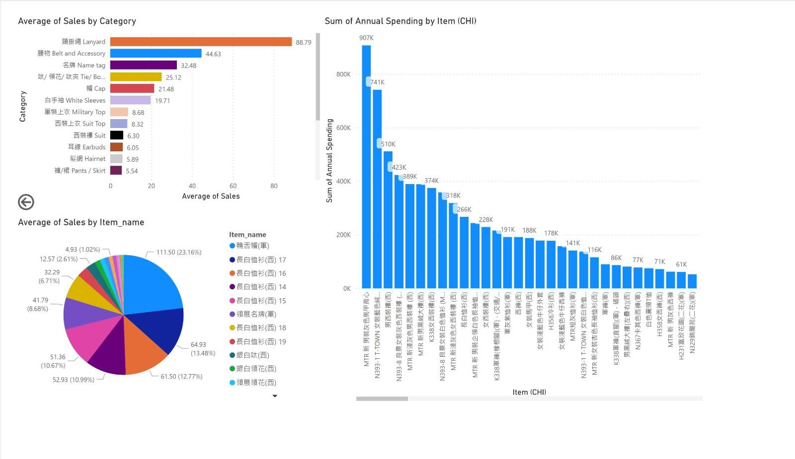
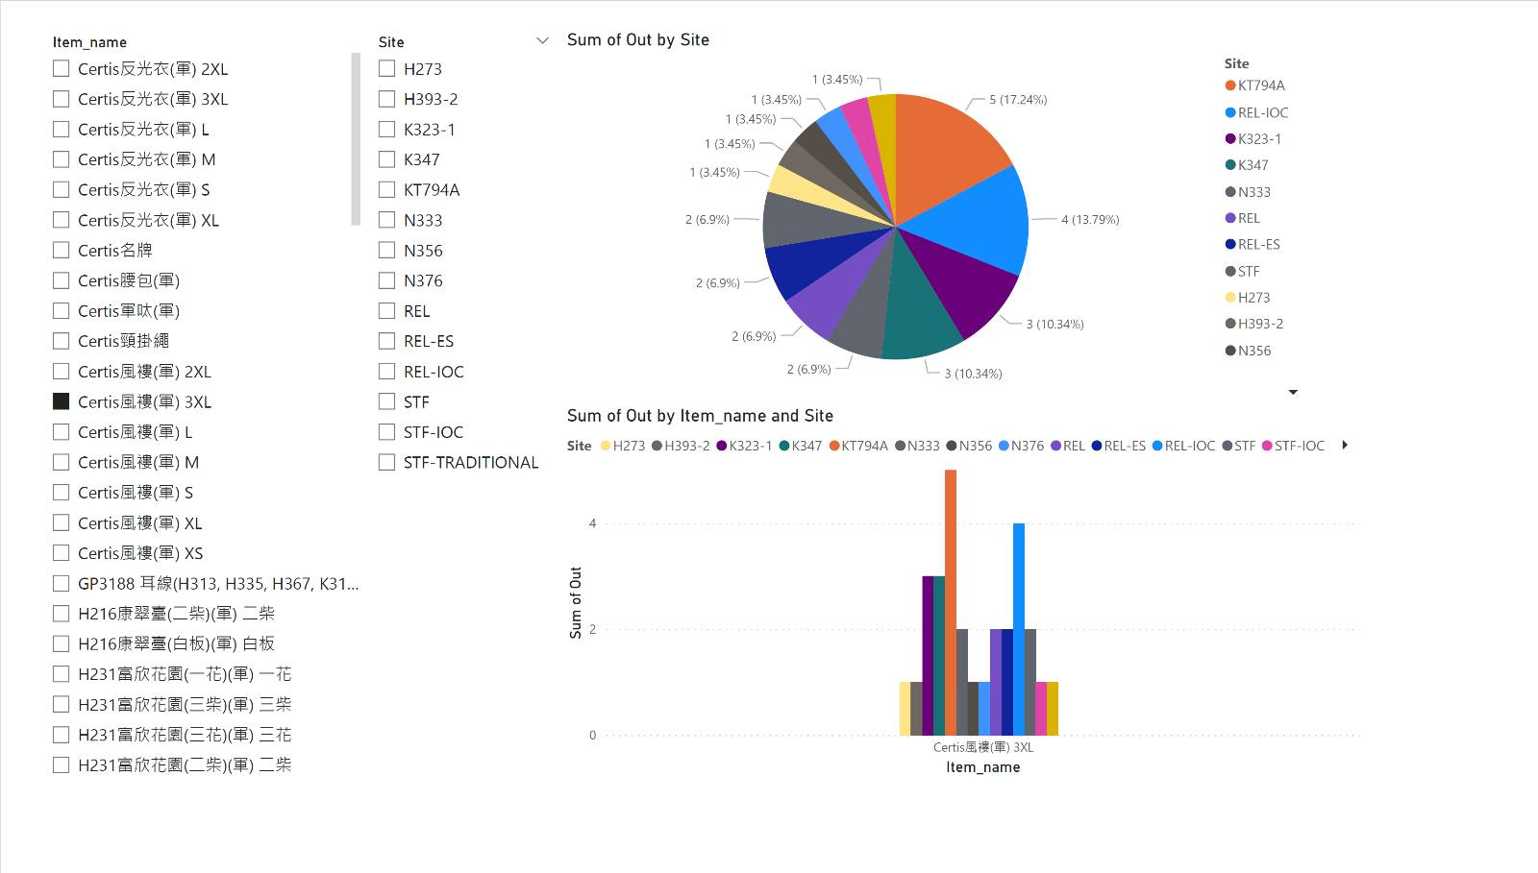
5) Data Visualization Data from Databricks to PowerBI

